Slide 1


Annual Cookie Report
Corner Bakery Café

Slide 2
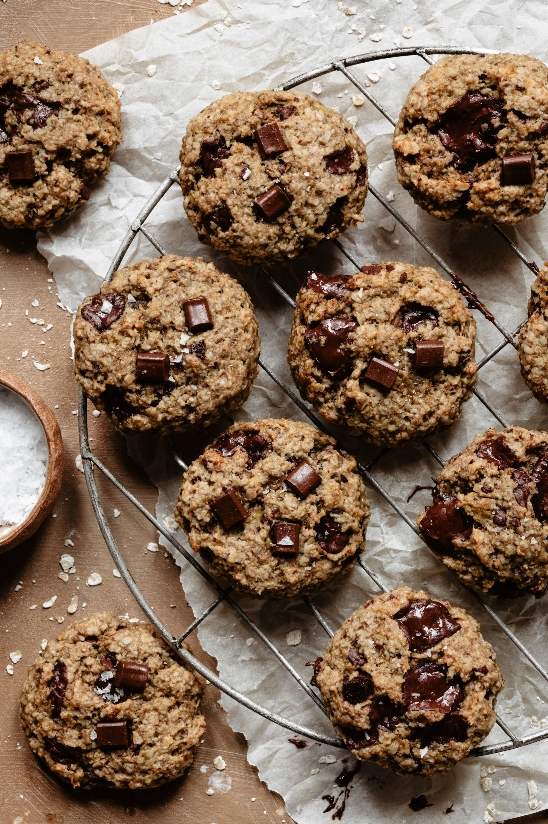
New Cookie Factory
Confidential
Opening Date: Q1 2025
Location: Orlando, FL
Cost: $5,000,000
Cookie Capacity: $100,000 cookies per day

Slide 3
Cookie Market
Florida was the dominant regional market in 2024.
Rising consumption of milk biscuits, especially among working class population in U.S. and Canada will drive the regional market further.
Moreover, availability of flavors, such as buttercream, chocolate, and peanut butter, is expected to contribute to the growth.

Slide 4

Sales Revenue
Rolled cookies segment generated the largest revenue of USD 5 million in 2024.
The rising popularity of these products due to various health benefits offered by them, such as improving the blood circulation and functioning of heart health, is the key factor driving the segment.
Bar cookies are expected to generate a revenue of more than USD 8 billion by 2025.
New product launches through online channels and supermarkets is projected to open growth avenues for the market.

Slide 5
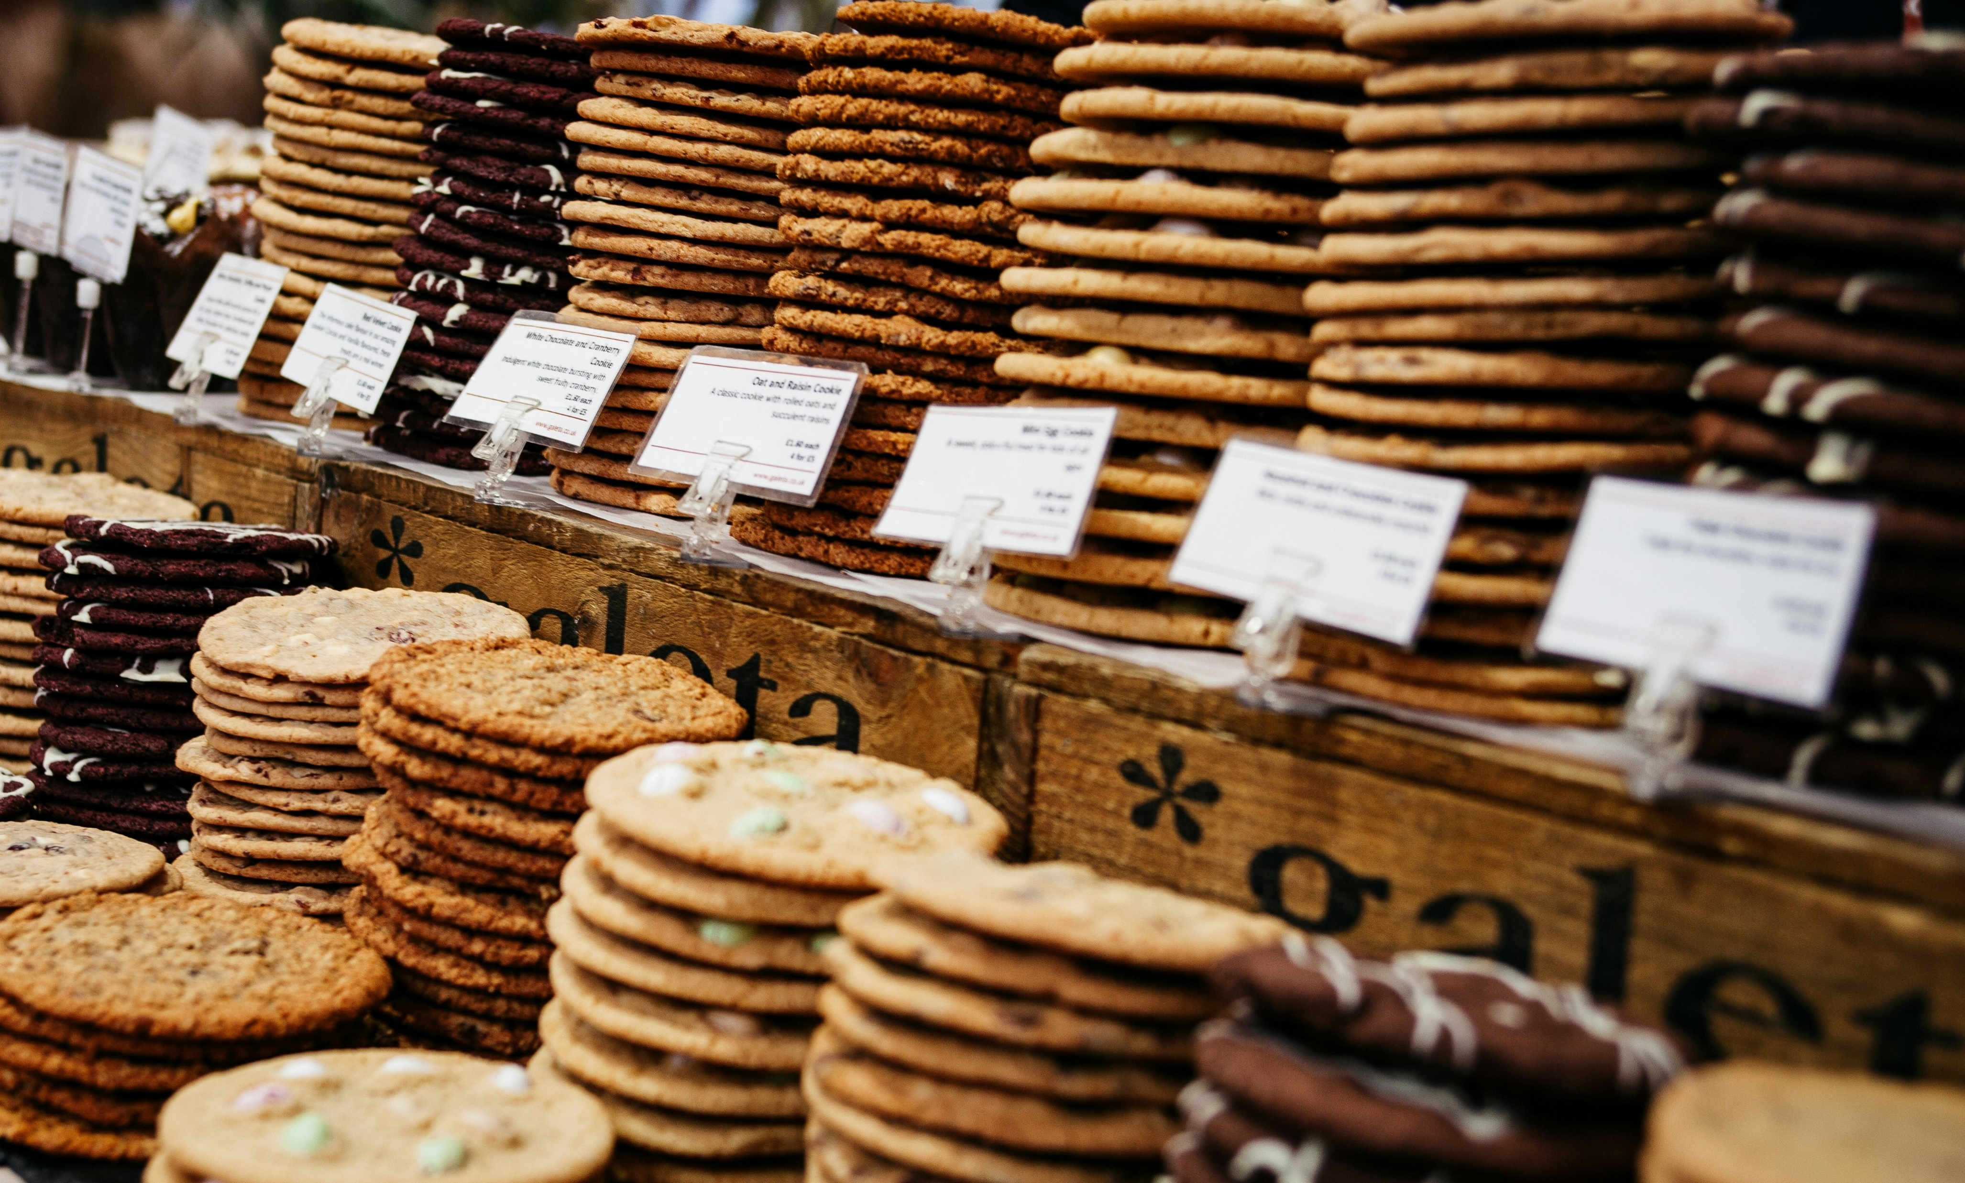
Market Report Scope
Product innovation coupled with the establishment of strategic business partnerships with the distributors located in key markets remain a critical success factor over the next eight years.
New product will be launched in 2025 called Pumpkin Cobbler Cookies.
Furthermore, Chef “E” is developing healthy low-fat cookies targeting the market of the excessive consumer.
Report Attribute | Details
Market size value in 2024 | USD 12.3 million
Revenue forecast in 2025 | USD 15.7 million
Growth rate | CAGR of 5.4% from 2021 to 2025
Segments covered | Production, distribution, region

Slide 6
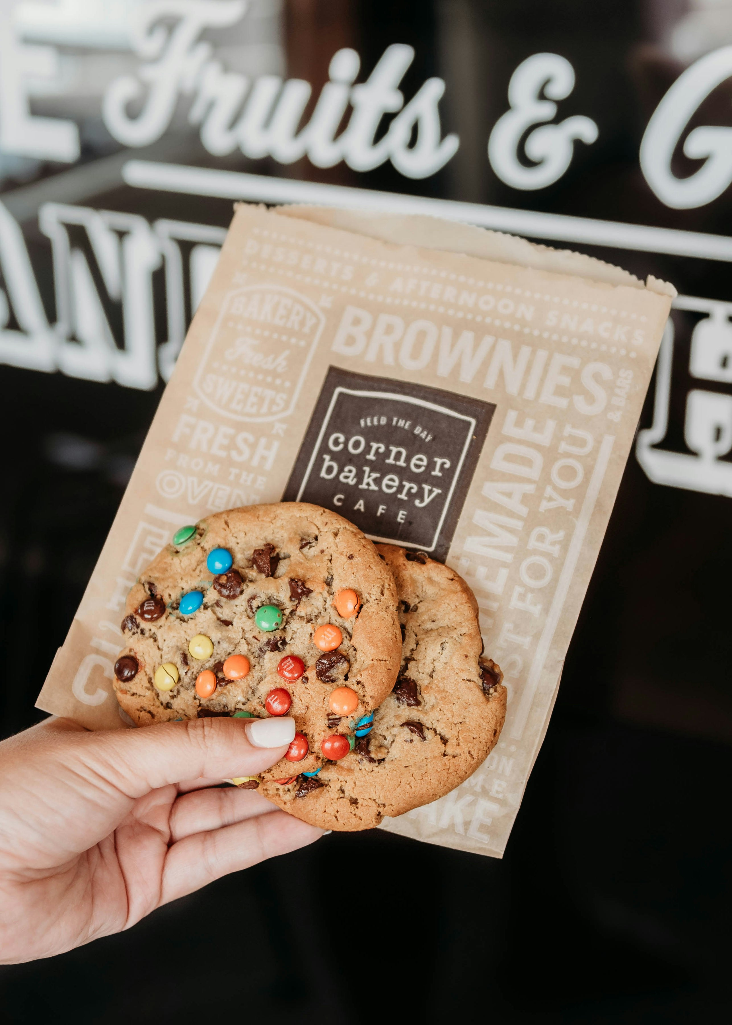
Customer Feedback

Slide 7

Thank you!
This research employs a comprehensive and iterative methodology focused on minimizing deviance to provide the most accurate estimates and forecast possible.

